Slide 1

A Low-Code Framework for Conversational AI Assistants
Leveraging Retrieval-Augmented Generation and LLMs
Supervisor
Dr. THIRUMAL M.E, Ph.D., Department of CSE VISTAS, Chennai
Dr. Kumar M.E, Ph.D., Department of CSE VISTAS, Chennai
Thanigaivel G - 24880107
MTECH- CSE – II Year

Slide 2
Abstract
Conversational AI has evolved rapidly with the advent of Large Language Models (LLMs), enabling intelligent and context-aware interactions between users and systems. However, integrating these models into enterprise applications typically requires extensive coding and AI expertise.
This project presents a low-code framework to build a Conversational AI Assistant using Retrieval-Augmented Generation (RAG) and LLMs, integrated with platforms like Oracle APEX. The assistant enables natural, domain-specific communication while retrieving accurate responses from enterprise knowledge sources. This approach reduces development time, lowers technical barriers, and makes AI accessible in business workflows like ERP or CRM systems.
The assistant enables users to interact with the modules using natural language, thereby improving usability, accessibility, and productivity. Leveraging low-code development platforms and state-of-the-art LLMs like GPT-4, the solution offers a scalable and adaptable approach to ERP interaction, reducing dependency on technical expertise.
Advantages:
Enables business users to query the systems using everyday Natural language.
Reduces dependency on technical staff (IT).
Demonstrates a low-code approach that speeds up development.
Bridges modern AI with legacy enterprise infrastructure.
2

Slide 3
Problem Inferred
Current enterprise chat systems, often based on rigid rule-based logic, fall short in delivering a natural and intuitive user experience. While they offer basic functionality, they lack contextual understanding, require frequent manual updates, and are unable to handle dynamic or complex queries. This leads to limited usability, increased support overhead, and reduced productivity.
A solution is needed to:
Enhance traditional rule-based chatbots by integrating Large Language Models (LLMs) and Retrieval-Augmented Generation (RAG) for smarter, context-aware interactions.
Simplify access to enterprise data and actions using natural language interfaces.
Improve accessibility and adoption for both technical and non-technical users across enterprise applications.
Key problems identified include:
Rigid interaction flows: Rule-based bots follow predefined paths, making them ineffective for handling dynamic or complex queries from users.
No natural language understanding: Queries like “What is my pending leave balance?” often go unrecognized unless phrased exactly as expected.
High dependency on IT teams: Non-technical users cannot rely on chatbots for advanced queries or data retrieval and must seek help from IT staff.

Slide 4
Objective
The primary objective of this project is to integrate LLM based smart assistant that simplifies application interaction using RAG, while requiring minimal development effort through low-code tools.
Key Objectives:
Design a conversational assistant interface and implement in the Enterprise Applications.
Integrate LLMs to understand user queries and perform data actions.
Use a RAG model to retrieve relevant application documents and data.
Minimize technical overhead by using low-code tools and reusable components.
Sub-objectives:
Improve accessibility of Enterprise data and reports.
Build an extensible architecture for future Enterprise modules like ERP / CRM.
Provide a secure and scalable framework for enterprise use.

Slide 5
Scope of this Project
This project focuses on the design and development of a prototype Conversational AI Assistant integrated into low-code enterprise applications. Rather than replacing existing rule-based chat systems, it aims to enhance user interaction by leveraging Retrieval-Augmented Generation (RAG) and Large Language Models (LLMs) to provide context-aware, intelligent responses from internal business data sources.
Within Scope:
Build a chatbot UI using Oracle APEX.
Connect the assistant to Enterprise applications like ERP / CRM.
Use LLMs to understand and respond to natural language queries.
Implement vector search to retrieve documents or past queries for better context.
Out of Scope (for now):
Voice-based assistants or speech recognition.
Real-time data syncing across multiple Applications.
Full security and authorization layer beyond the prototype.

Slide 6
Proposed Work Outline
This system combines a low-code frontend, an AI-powered backend, and RAG data sources using a modular architecture.
Workflow Overview:
User types a query in the APEX chatbot interface.
The query is sent to to Python (Flask) backend via REST
Embeddings created, matched with Knowledge Base (RAG using LangChain/LlamaIndex)
The LLM uses the retrieved context to generate a response.
The response is returned to the Apex UI.
System Layers:
Frontend: Oracle APEX with dynamic actions and RESTful APIs.
Middleware: Python Flask for embedding, LLM orchestration.
RAG Engine: Uses LangChain or LlamaIndex to retrieve document chunks.
LLM Integration: GPT or open-source models to generate text.
Data Layer: Oracle ERP tables, policy docs, internal knowledge base.

Slide 7
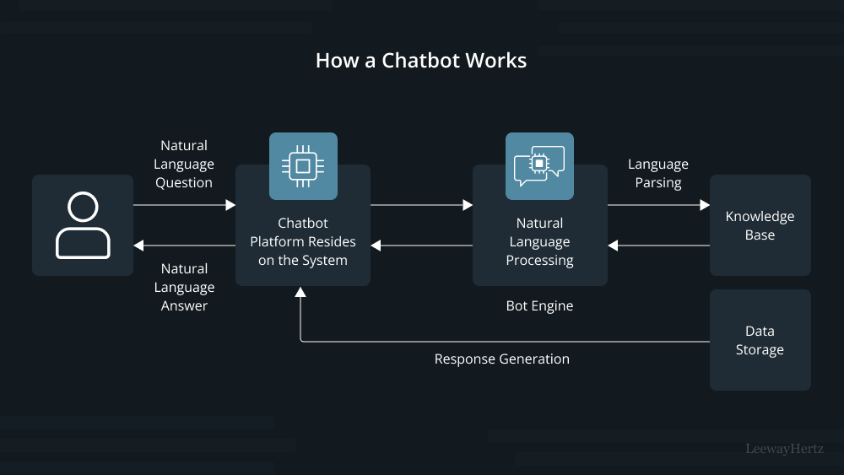
Block Diagram

Slide 8
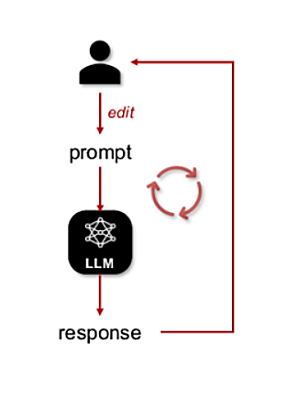
Module Flow Diagram

Slide 9
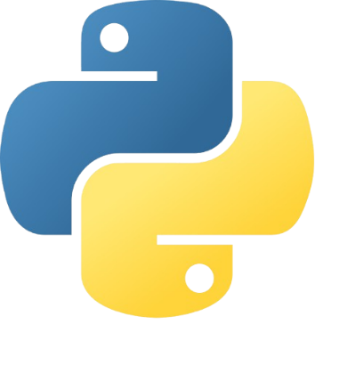
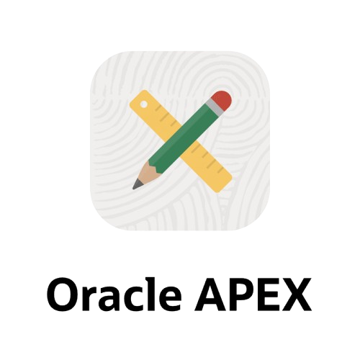
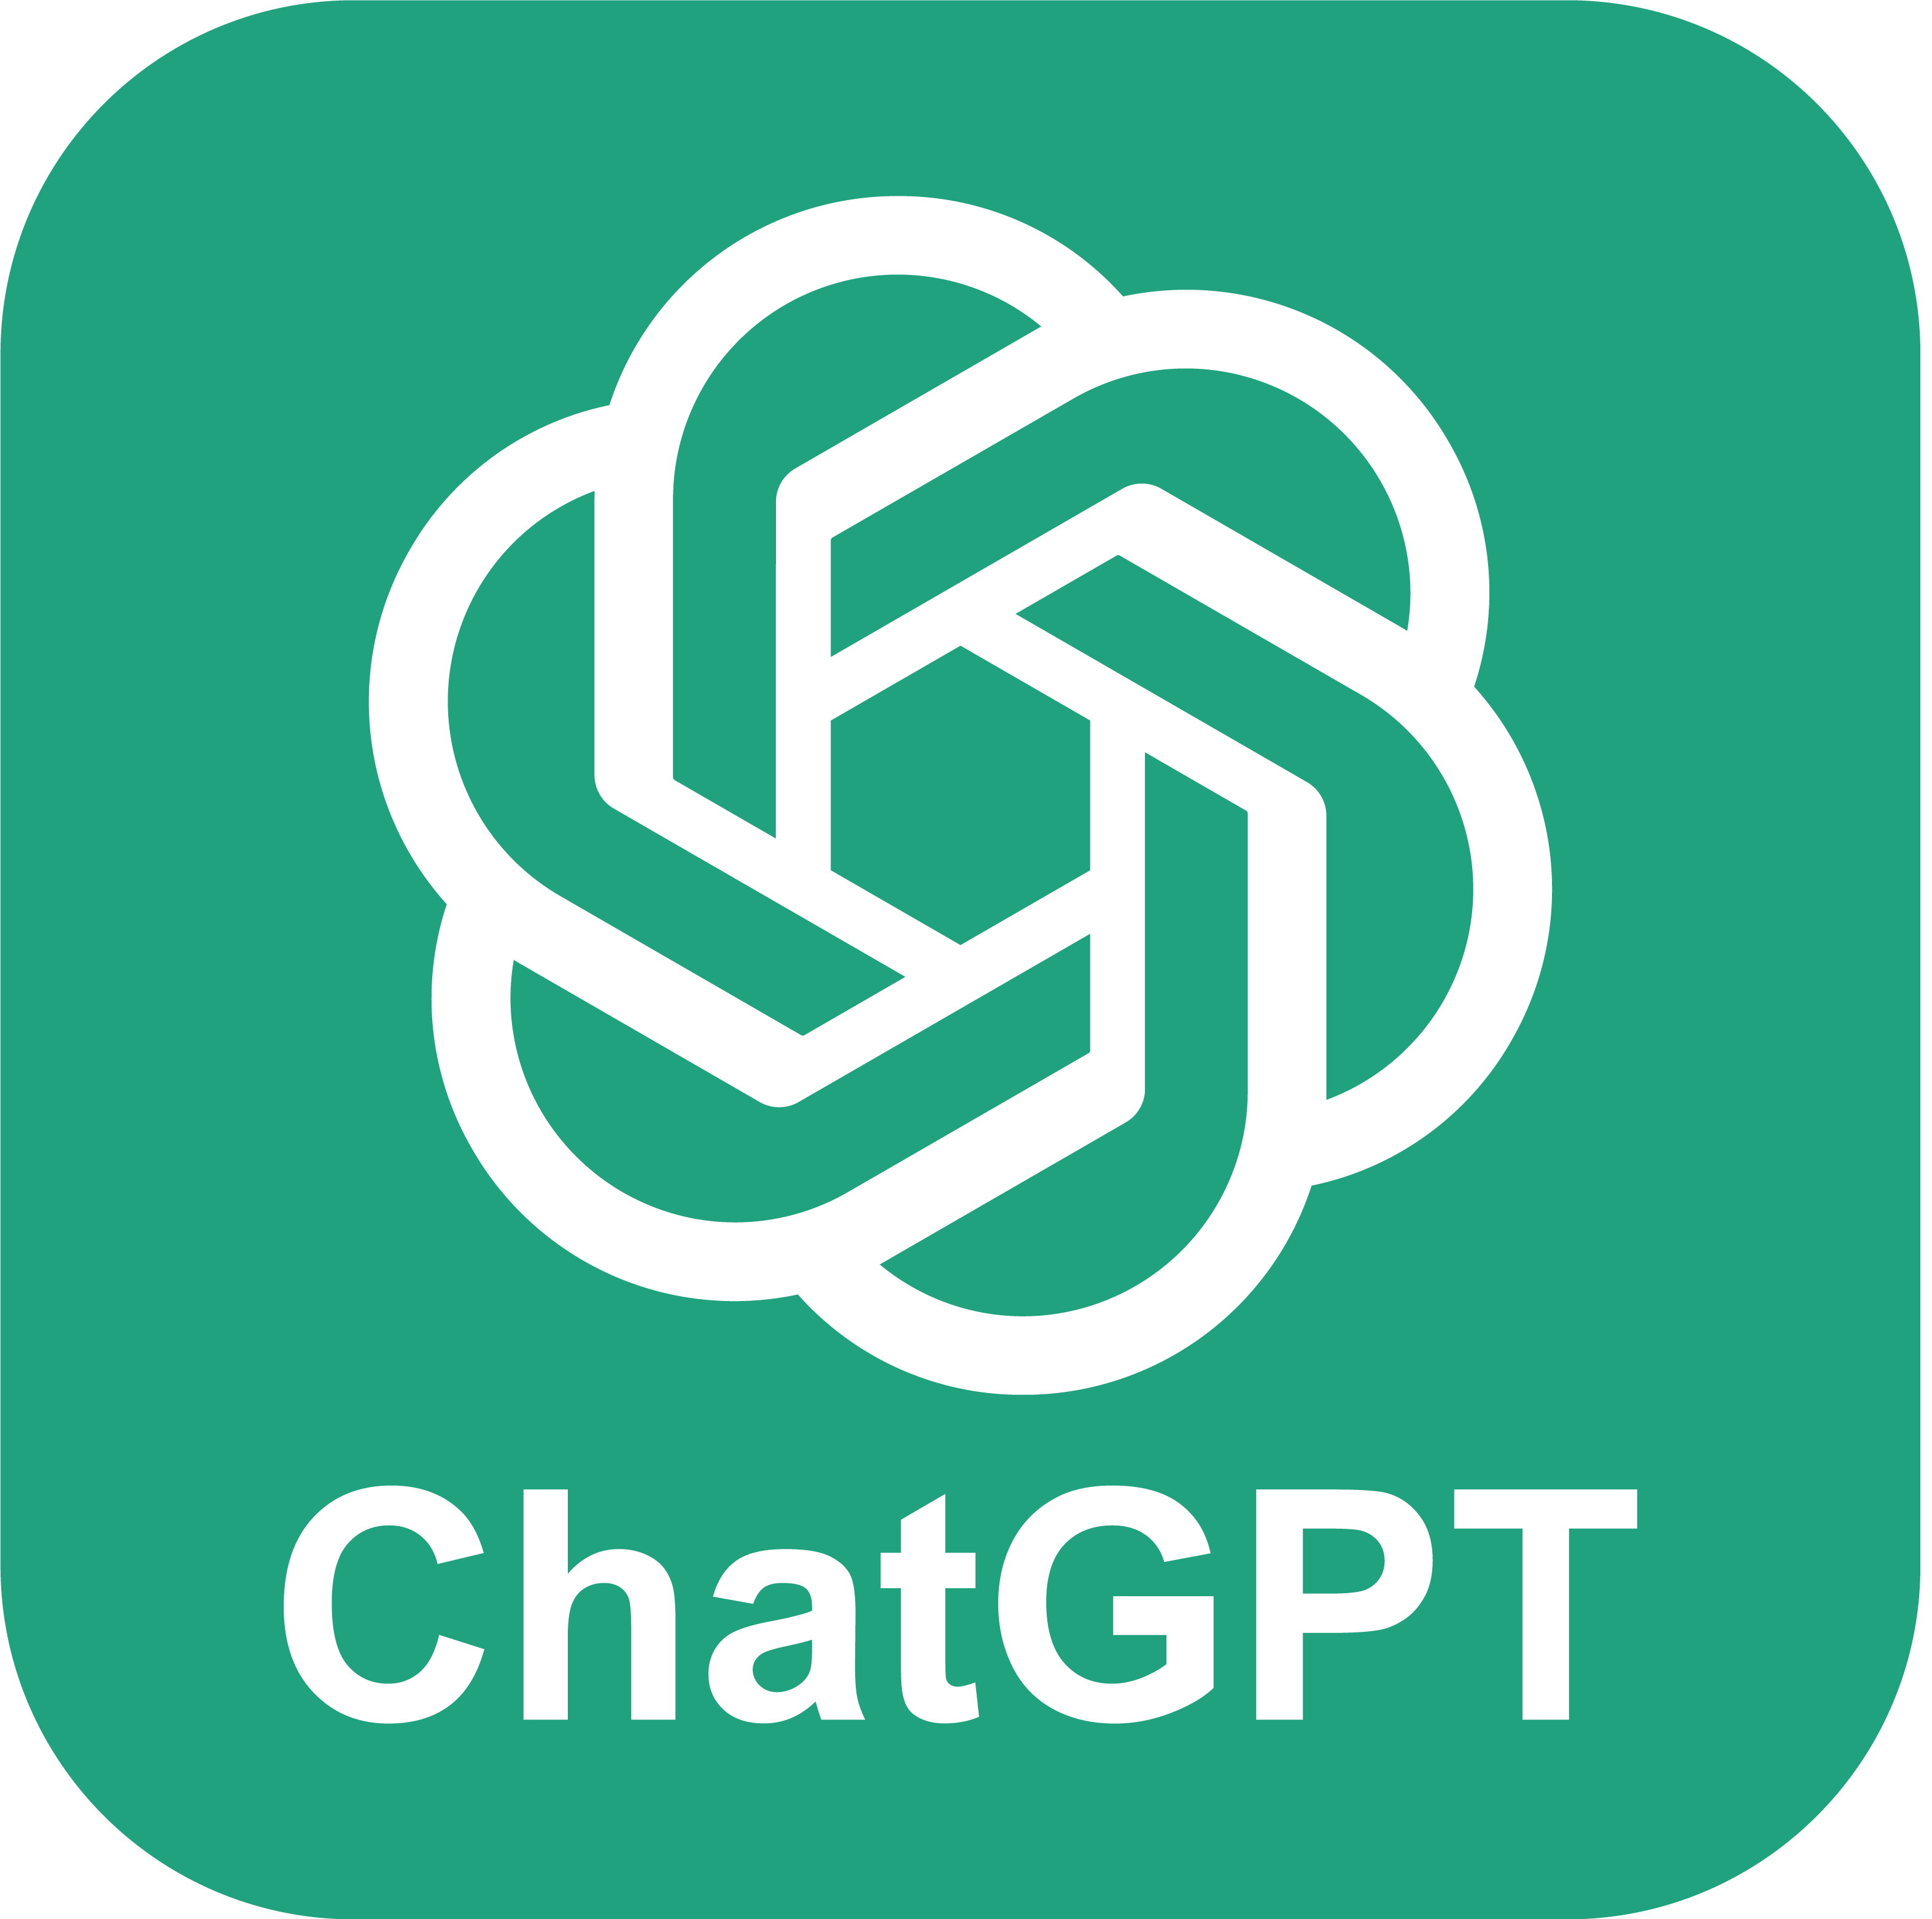
Tools & Technologies Used
Low-Code Platform:
Oracle APEX – For building UI, managing session state, and calling REST services.
LLM & AI Frameworks:
OpenAI GPT-4 / Cohere / HuggingFace Transformers
LangChain / LlamaIndex – For orchestrating the RAG
Storage & Retrieval:
ChromaDB / FAISS / Pinecone – Vector search for document embeddings
Oracle DB – Core ERP database
Languages & Protocols:
PL/SQL, JavaScript, Python
RESTful APIs for integration

Slide 10
Literature Review
Sno | Year | Title of the Paper | Author & Publication Details | Inference
1 | 2025 | RAGVA: Engineering Retrieval-Augmented Generation–based Virtual Assistants in Practice | R. Yang et al. (arXiv / IEEE-indexed workshops) | Provides engineering practices for implementing RAG-based conversational assistants. Advantage: Practical blueprint for RAG integration. Limitation: More experimental, not yet widely deployed in enterprise low-code platforms.
2 | 2025 | Beyond Text: Implementing Multimodal LLM-Powered Multi-Agent Systems Using a No-Code Platform | Cheonsu Jeong | Explores a no-code platform for building multi-agent conversational systems with RAG. Advantage: Demonstrates multimodal conversational AI in low-code setting. Limitation: Early-stage work; scalability in enterprise settings untested.
3 | 2025 | Low-Code RAG-LLM Framework for Context-Aware Querying in Electrical Standards, Design, and Research | Soham Ghosh & Gaurav Mittal (preprint on Preprints.org) Preprints | Introduces a low-code RAG-LLM pipeline built using N8N, tailored for domain-specific querying; modular, supports reranking, contextual retrieval, knowledge-graph augmentation; evaluated on NFPA, IEEE Xplore documents Preprints
4 | 2024 | Generating a Low-Code Workflow via Task Decomposition and RAG | O. Marquez Ayala & P. Béchard | Introduces Task Decomposition + RAG as design patterns for enterprise workflows. Advantage: Connects low-code principles with RAG-based automation. Limitation: Conceptual framework; lacks industrial case studies.
5 | 2024 | White-box LLM-supported Low-code Engineering: A Vision and First Insights | Y. Cai, Z. Xing, et al. (ACM/IEEE MODELS Companion) | Explores how LLMs can be integrated into low-code platforms for model-driven engineering. Advantage: Provides first architectural insights into combining low-code and LLM. Limitation: Still conceptual, lacks large-scale empirical validation.
6 | 2023 | The Next Frontier in Software Development: AI-Augmented Software Development Processes | IEEE Software Editorial Board | Argues LLMs can accelerate no-code/low-code development by automating repetitive tasks. Advantage: Establishes LLMs as co-developers. Limitation: Discusses opportunities broadly, without specific RAG or conversational AI focus.

Slide 11
Literature Review
Sno | Year | Title of the Paper | Author & Publication Details | Inference
1 | 2025 | RAGVA: Engineering Retrieval-Augmented Generation–based Virtual Assistants in Practice | R. Yang et al. (arXiv / IEEE-indexed workshops) | Provides engineering practices for implementing RAG-based conversational assistants. Advantage: Practical blueprint for RAG integration. Limitation: More experimental, not yet widely deployed in enterprise low-code platforms.
2 | 2025 | Beyond Text: Implementing Multimodal LLM-Powered Multi-Agent Systems Using a No-Code Platform | Cheonsu Jeong | Explores a no-code platform for building multi-agent conversational systems with RAG. Advantage: Demonstrates multimodal conversational AI in low-code setting. Limitation: Early-stage work; scalability in enterprise settings untested.
3 | 2024 | Generating a Low-Code Workflow via Task Decomposition and RAG | O. Marquez Ayala & P. Béchard | Introduces Task Decomposition + RAG as design patterns for enterprise workflows. Advantage: Connects low-code principles with RAG-based automation. Limitation: Conceptual framework; lacks industrial case studies.
4 | 2024 | White-box LLM-supported Low-code Engineering: A Vision and First Insights | Y. Cai, Z. Xing, et al. (ACM/IEEE MODELS Companion) | Explores how LLMs can be integrated into low-code platforms for model-driven engineering. Advantage: Provides first architectural insights into combining low-code and LLM. Limitation: Still conceptual, lacks large-scale empirical validation.
5 | 2023 | Application of Large Language Models to Software Engineering Tasks: Opportunities, Risks, and Implications | Multiple authors (IEEE Software) | Surveys how LLMs can automate coding, testing, and documentation. Advantage: Highlights productivity and low-code-like automation. Limitation: Raises concerns on trust, explainability, and legal compliance.
6 | 2023 | The Next Frontier in Software Development: AI-Augmented Software Development Processes | IEEE Software Editorial Board | Argues LLMs can accelerate no-code/low-code development by automating repetitive tasks. Advantage: Establishes LLMs as co-developers. Limitation: Discusses opportunities broadly, without specific RAG or conversational AI focus.

Slide 12
Literature Review
Conversational AI has evolved from rule-based systems to neural models and, more recently, to large language models (LLMs) such as GPT-3, PaLM, and LLaMA, which enable fluent and rich dialogues but often suffer from hallucinations in domain-specific contexts.
Retrieval-Augmented Generation (RAG) addresses this limitation by grounding responses in external knowledge, with early models like REALM and DPR improving factual accuracy. Advances in vector search through FAISS, Milvus, Pinecone and Oracle 23ai have enabled scalable and efficient retrieval for large document collections.
In parallel, low-code and no-code platforms such as Mendix, PowerApps, Rasa X, and Botpress make application development more accessible but lack seamless integration of RAG pipelines. Middleware frameworks like LangChain, LlamaIndex, and Semantic Kernel allow orchestration of LLMs with retrieval but require significant coding expertise.
Thus, a research gap exists for an end-to-end low-code framework that combines LLMs and RAG with built-in governance, monitoring, and evaluation, enabling non-expert users to build reliable, domain-specific conversational assistants.

Slide 13
Challenges
Technical Challenges:
Managing latency during real-time vector retrieval and LLM inference.
Token limitations of LLMs when processing large documents.
Security Concerns:
Ensuring sensitive ERP data is protected in transmission and inference.
Implementing user access controls at the assistant level.
Functional Challenges:
Understanding ambiguous queries.
Training users to effectively use conversational ERP.

Slide 14
Conclusion
This project validates the potential of integrating Large Language Models (LLMs) with low-code platforms to modernize Enterprise system interaction. Through a conversational AI assistant, we bridge the gap between complex enterprise data and everyday user making ERP access intuitive and intelligent.
Summary:
Demonstrates real world impact of LLM + Low-Code synergy
Simplifies Enterprise Application access using natural language, reducing training needs
Solves a real business problem with emerging AI technologies.
Modular design supports future scalability & enterprise integration.
Lays foundation for domain-specific AI assistants across business verticals
Combines low-code and AI for maximum impact.

Slide 15
Future Enhancement
This prototype opens the door to more advanced capabilities and broader applications across business domains.
Planned Enhancements:
Voice-based interaction: Integrate speech-to-text and text-to-speech APIs.
Domain-tuned LLMs: Fine-tune models on specific ERP datasets.
Real-time alerting: Proactive assistant that suggests actions based on trends.
Cross-platform integration: Use the assistant in mobile apps, intranets, or CRM.
Scalability Options:
Multi-lingual support.
Integration with SAP, ODOO, or other ERPs.
Role-based conversation contexts.

Slide 16
REFERENCES
Siar Sarferaz (2025). Implementing Generative AI into ERP Software.
Yue Yin, Stefan Decker (2025). An LLM-Driven Chatbot in Higher Education for Databases and Information Systems
E.A. Chavez Urbiola , Juan Tarven (2024). Intelligent Driving Assistance System using RAG.
Sara Aboukadri (2025). Leveraging RAG and LLMs for Access Control Policy Extraction From User Stories in Agile Software Development.
Oracle APEX Documentation. https://docs.oracle.com/en/database/oracle/apex/
LlamaIndex: https://llamaindex.ai
LangChain Docs: https://docs.langchain.com
OpenAI Embeddings API. https://platform.openai.com/docs/guides/embeddings

Slide 17

THANK YOU
Dr. Thirumal (Supervisor)
Dr. Kumar (Supervisor)

